Slide 1
Technology in History
Sarah Hatchell
Victor Valley High School
Fall 2016 Technology Prof. Dev.

Slide 2
Introduction
Sarah Hatchell
Teaching since 2005
Masters in Arts in Education 2009
AP European History teacher since 2008-2009
AVID Teacher since 2014-15 school year
Hobbies…learning quilting. ☺

Slide 3
Welcome!
Today is about learning to incorporate technology into the History classroom.
Many topics will be covered.
Apps for iPad/Android
Social Media
Lesson Plan Ideas
If you have any questions regarding this presentation, apps, websites, programs, etc. contact me at shatchell@vvuhsd.org or visit my webpage at: www.tinyurl.com/jyq488h

Slide 4
Netiquette
First of all:
What is “Netiquette”?
Why is it important?
How do you enforce it?

Slide 5
Useful APPS & Websites
Decide Now
CHEGG-Flashcards +
www.noredink.com

Slide 6
Keeping Contact
Remind (a.k.a. Remind 101)
Instagram, Facebook, Twitter.
These platforms allow students to check homework or contact you regarding absences.

Slide 7
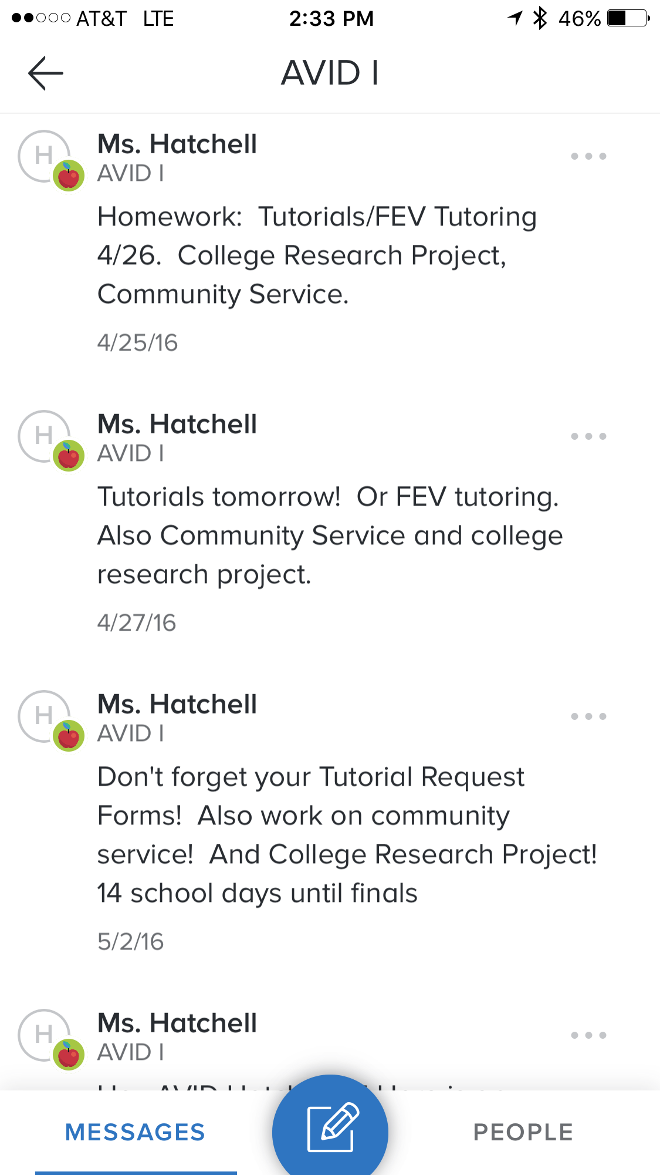
Remind Assignments
Join Code Needed.
Students text a number with a short phrase.
81010
You can set the phrase
@europea
Push out assignments to students.
Assignments can be scheduled.
Images/Photos.

Slide 8
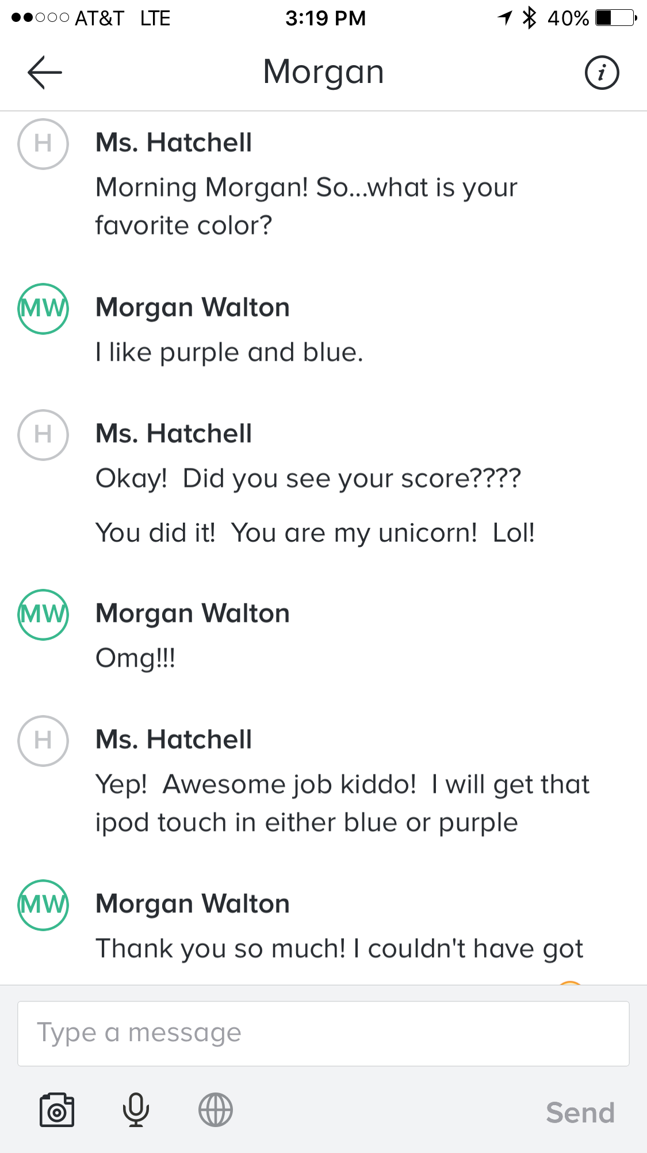
Remind
Message Center
Secure messaging to individual
students.
Can be used with APP (on
Android & App Store)

Slide 9
Pictures via Remind

Slide 10
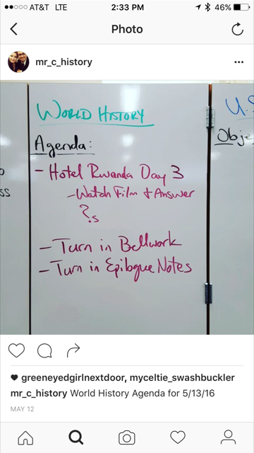
Instagram
Similar to Remind.
No individual communication.
No control over who joins.
Thank you Henry Citarella for letting me snag your Instagram!!!

Slide 11
Twitter
Social Media Platform
Can be used for classroom use.
Page must be dedicated to classroom.
Twitter can use #hashtags to create online dialogs.

Slide 12
Social Learning Platforms
Edmodo
Schoology
Google Classroom
Create Classrooms
Post assignments
Quizzes
APP Integration (for Android and Apple-for students & teachers!)
Teacher Communities (Edmodo & Schoology)

Slide 13
Prezi’s
A new way to PowerPoint.
A bit more fun than the usual….for you and them!
It is free for teachers & students.
Also PowerPoints can be imported!
Student Example

Slide 14
Symbaloo
Keep Webpages organized per class.
Easy to add & customize.
Create individual pages for each subject.

Slide 15
Webpages
Google Websites
Weebly
Building a webpage can be of great assistance to your classroom.
Weebly is easier to use….and its free.

Slide 16
PBL-Buck Institute
Rubrics-Contracts-Responsibilities Group Projects:
Project Based Learning
Flips Classroom

Slide 17
Lesson Plans
WebQuests
Resumes! (Prezi!)

Slide 18
Facebook LP
Students create a Facebook Page Presentation
Provide students with a format via power point either linked to a learning platform or on your website.
It will look somewhat like this…..

Slide 19
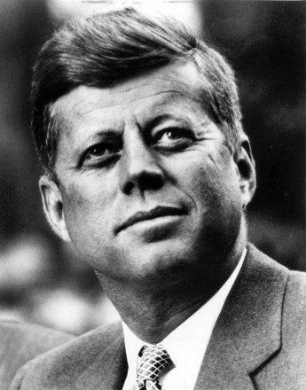
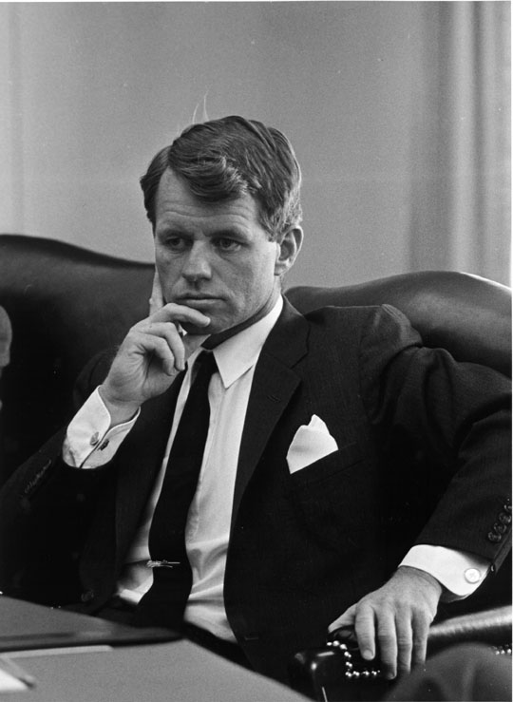
facebook
Timeline
About
Friends
Photos
John F. Kennedy
Logout
John F. Kennedy is preparing to sign the Nuclear Test Ban Treaty
Wall
Info
Photos
Boxes
Write something…
Share
View photos of JFK (5)
Send JFK a message
John F. Kennedy is preparing to sign the Nuclear Test Ban Treaty
October 7, 1963
Poke message
Bobby Kennedy to John F. Kennedy Have you finalized your plans for the Texas trip?
October 1, 1963
Information
Networks:
Washington D.C.
Birthday:
May 29, 1917
Political:
Democrat
Religion:
Catholic
Hometown:
Brookline, Mass.
John F. Kennedy I can’t believe I had to actually send the National Guard to Alabama just so some kids could go to college!
June 11, 196
John F. Kennedy is so glad we avoided war with the Russians! That Crisis in Cuba had my blood boiling!
October 28, 1962
Friends
John F. Kennedy hopes everyone realizes how serious I am about putting a man on the moon!!!
September 9, 1962
LBJ
Frank
Marilyn
John F. Kennedy wishes the Bay of Pigs invasion had gone better! I think Castro is going to be a major thorn in the side of the U.S.
April 17, 1961
Bobby
Jackie
Robert

Slide 20
Thank you!
If you have any questions regarding this presentation, apps, websites, programs, etc. contact me at shatchell@vvuhsd.org or visit my webpage at: www.tinyurl.com/jyq488h

