Slide 1
The Art
of the
Italian Renaissance
By: Ms. Hatchell
Silverado High School

Slide 2
Art and Patronage
Italians were willing to spend a lot of money on art.
Art communicated social, political, and spiritual values.
Italian banking & international trade interests had the money.
Public art in Florence was organized and supported by guilds.
Therefore, the consumption of art was used as a form of competition for social & political status!

Slide 3
Characteristics
of
Renaissance Art

Slide 4
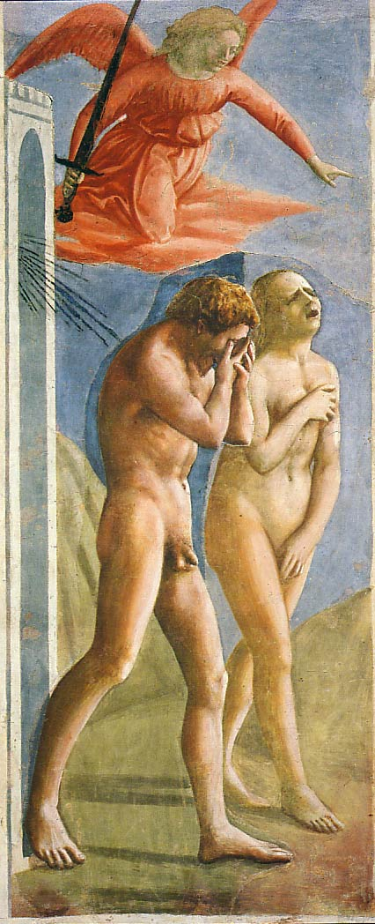
1. Realism & Expression
Expulsion from the Garden
Masaccio
1427
First nudes since classical times.

Slide 5
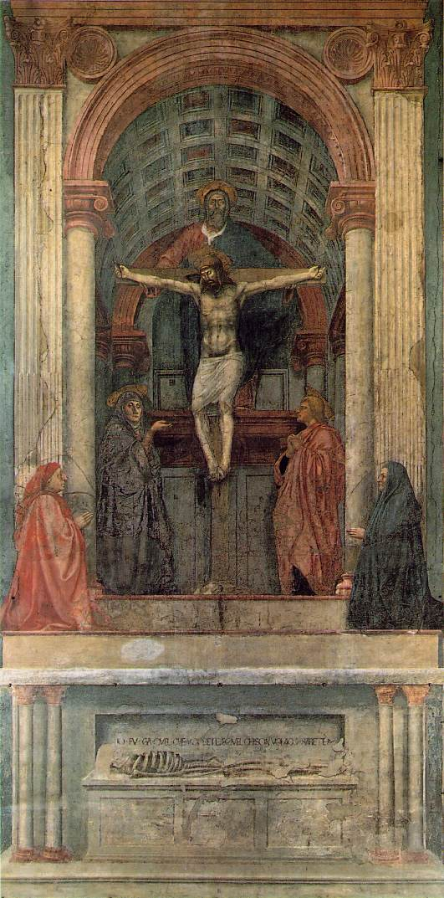
2. Perspective
The Trinity
Masaccio
1427
Perspective!
Perspective!
Perspective!
Perspective!
Perspective!
Perspective!
Perspective!
First use of linear perspective!
What you are, I once was; what I am, you will become.

Slide 6
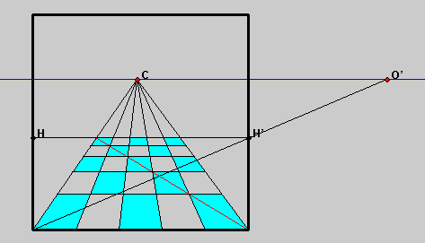
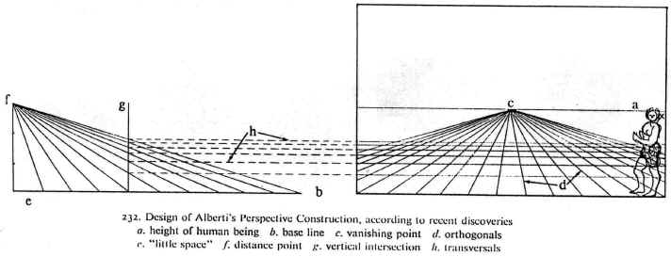
Perspective

Slide 7
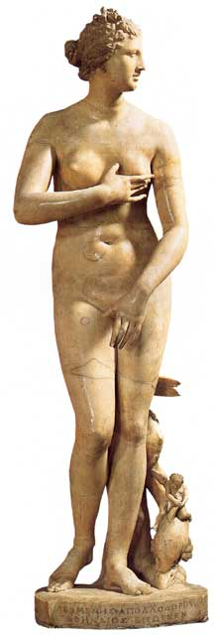
3. Classicism
Greco-Roman influence.
Secularism.
Humanism.
Individualism → free standing figures.
Symmetry/Balance
The “Classical Pose” Medici “Venus” (1c)

Slide 8
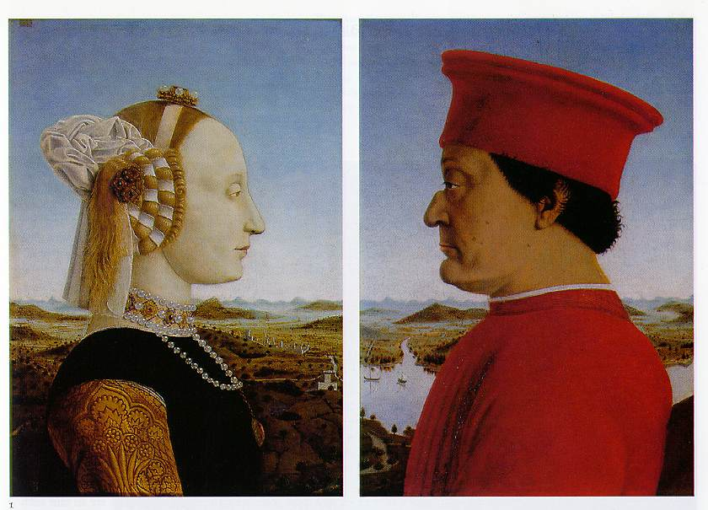
4. Emphasis on Individualism
Batista Sforza & Federico de Montefeltre: The Duke & Dutchess of Urbino
Piero della Francesca, 1465-1466.

Slide 9
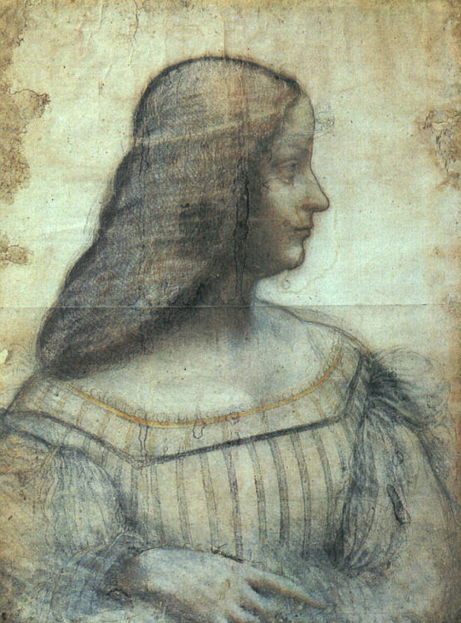
Isabella d’Este – da Vinci, 1499
1474-1539
“First Lady of the Italian Renaissance.”
Great patroness of the arts.
Known during her time as “First Lady of the World!”

Slide 10
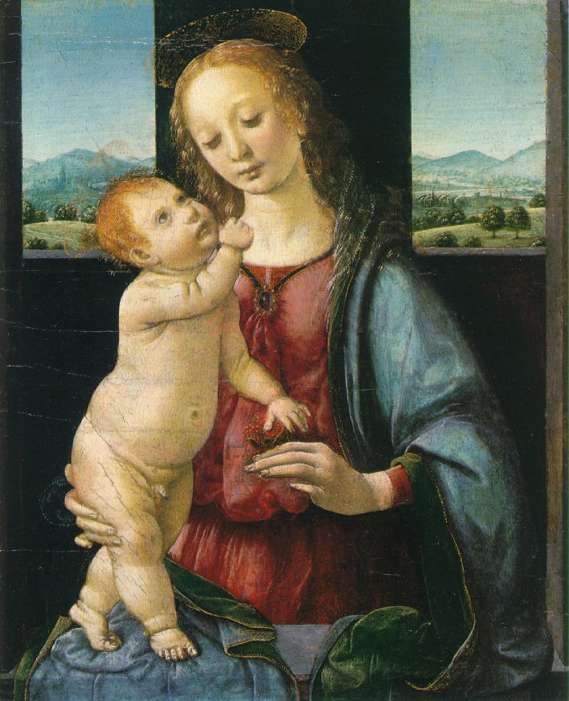
5. Geometrical Arrangement of Figures
The Dreyfus Madonna with the Pomegranate
Leonardo da Vinci
1469
The figure as architecture!

Slide 11
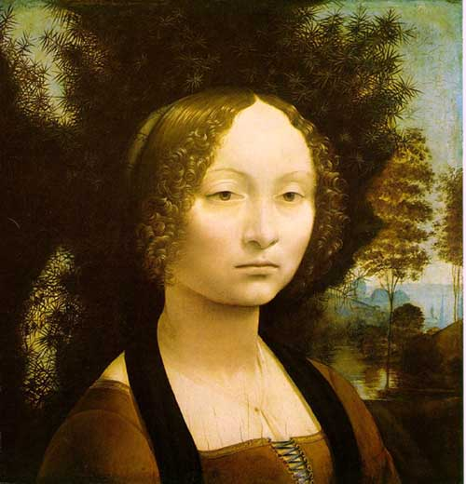
6. Light & Shadowing/Softening Edges
Sfumato
Chiaroscuro

Slide 12
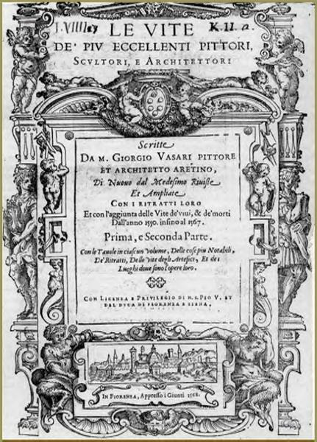
7. Artists as Personalities/Celebrities
Lives of the Most Excellent Painters, Sculptors, and Architects
Giorgio Vasari
1550

Slide 13
Warm Up 9/11/2008
Get Candace Gregory Text.
Turn to page 199
Finish Vasari, “The Life Of Leonardo Da Vinci.
Be Prepared to discuss…as well as Dante’s Sonnets.

Slide 14
Lesson Objectives
Trace Developments in Literacy, education, and communication. (pages 321-27)
Development in Social, Economic, and Political though. (pages 333-35)
Trace the major trends in Literature (pages 318-31)

Slide 15
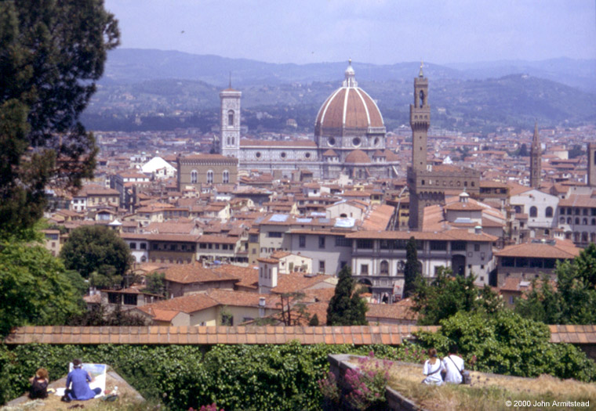
Renaissance Florence

Slide 16
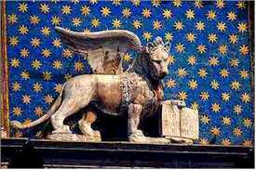
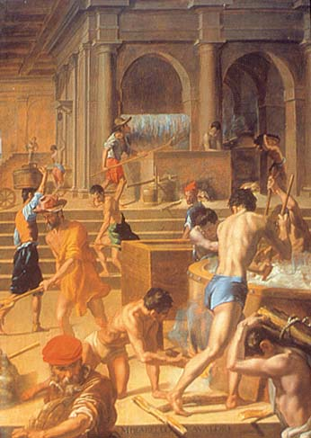
Renaissance Florence
Florentine lion: symbol of St. Mark
The Wool Factory by Mirabello Cavalori, 1570
1252 – first gold florins minted

Slide 17
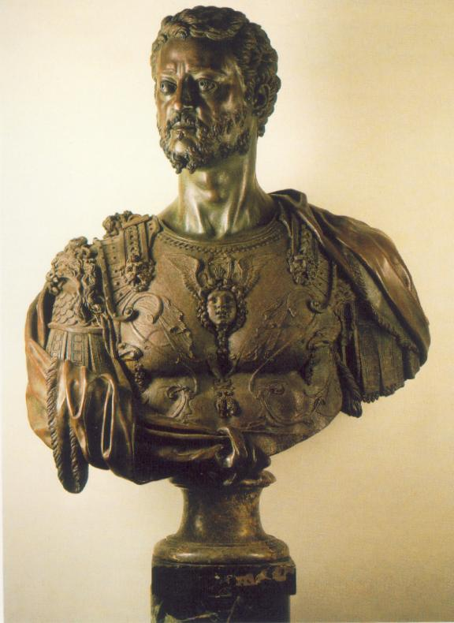
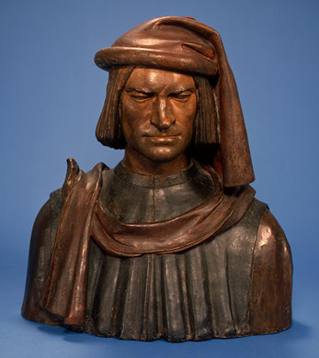
Lorenzo the Magnificent
Cosimo de Medici
1478 - 1521
1517 - 1574

Slide 18
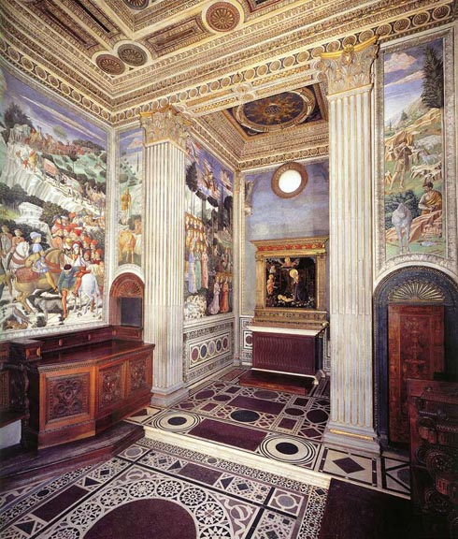
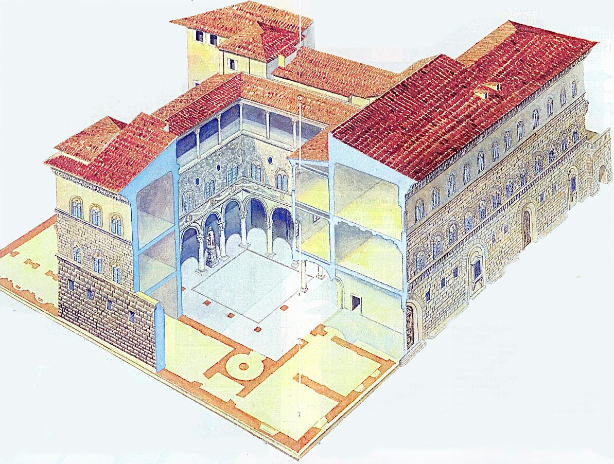
Florence Under the Medici
Medici Chapel
The Medici Palace

Slide 19
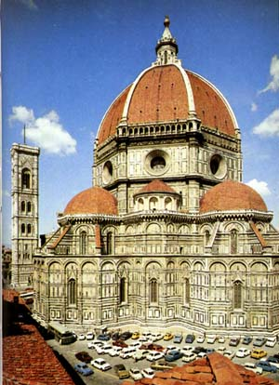
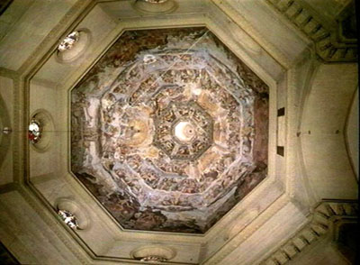
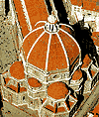
Filippo Brunelleschi 1377 - 1436
Architect
Cuppolo of St. Maria del Fiore

Slide 20
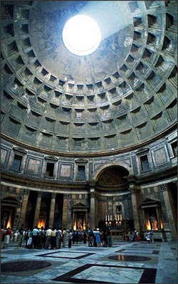
Filippo Brunelleschi
Commissioned to build the cathedral dome.
Used unique architectural concepts.
He studied the ancient Pantheon in Rome.
Used ribs for support.

Slide 21
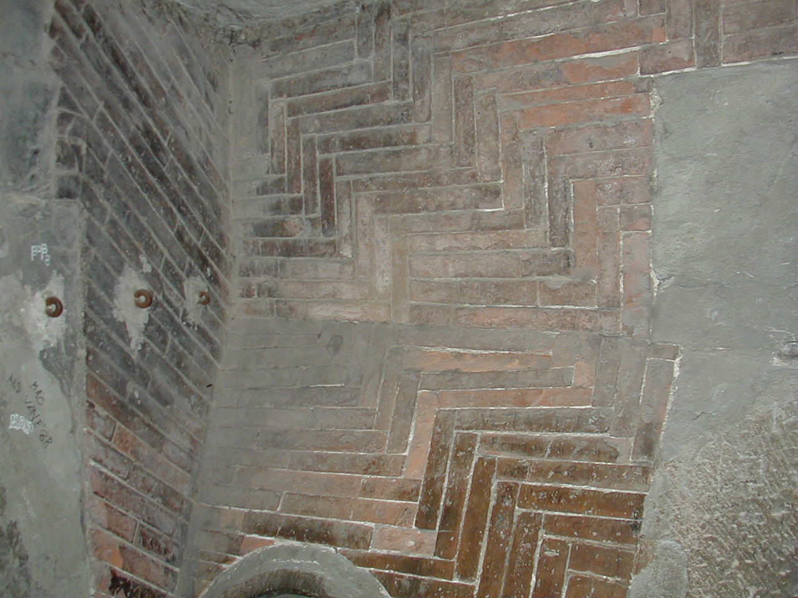
Brunelleschi’s “Secret”

Slide 22
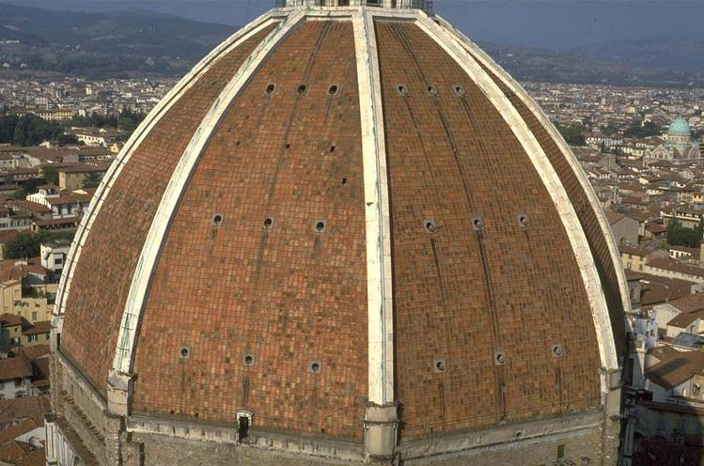
Brunelleschi’s Dome

Slide 23
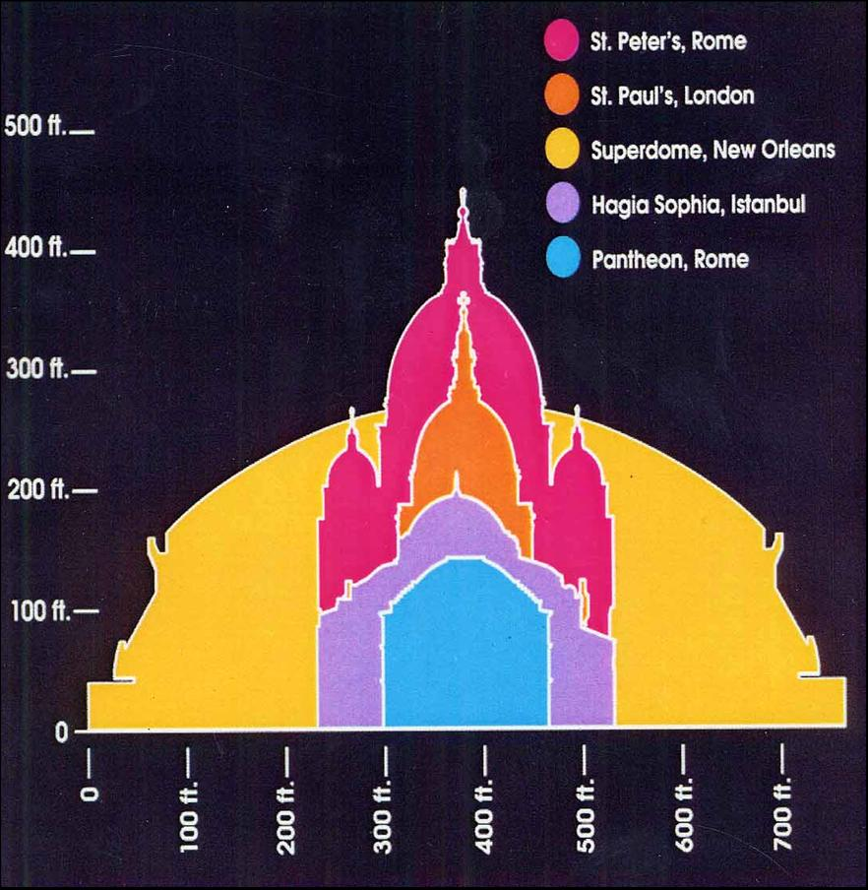
Comparing Domes

Slide 24
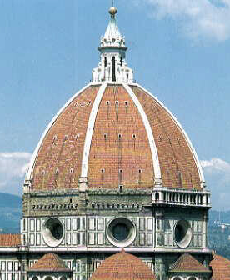
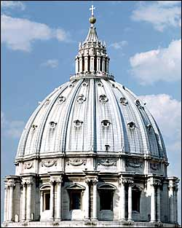
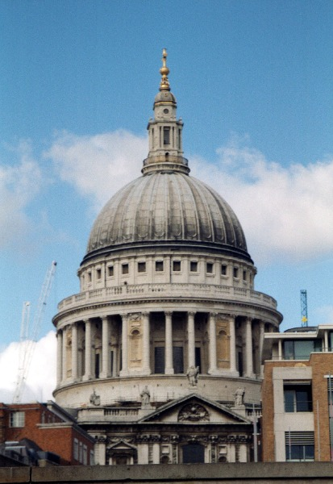
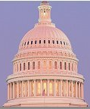
Other Famous Domes
Il Duomo St. Peter’s St. Paul’s US capital (Florence) (Rome) (London) (Washington)

Slide 25
The Ideal City Piero della Francesca, 1470

Slide 26
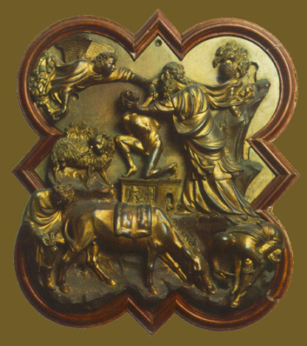
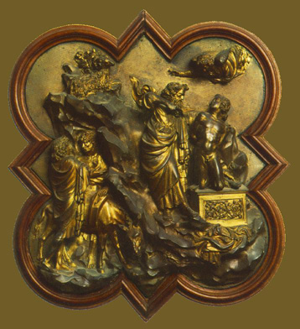
A Contest to Decorate the Cathedral: Sacrifice of Isaac Panels
Brunelleschi
Ghiberti

Slide 27
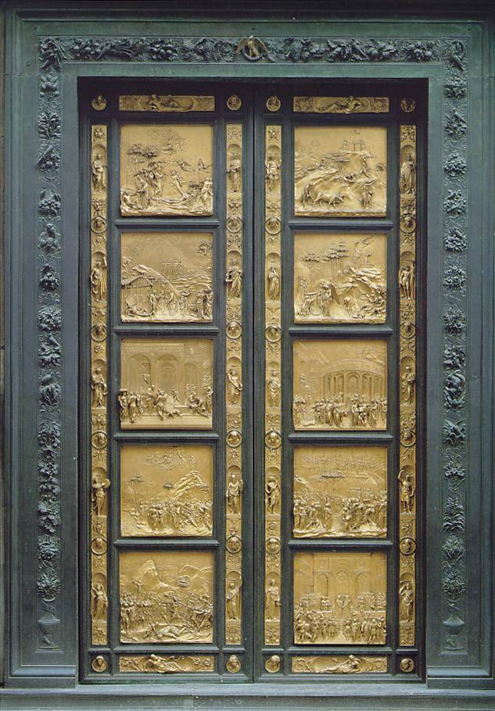
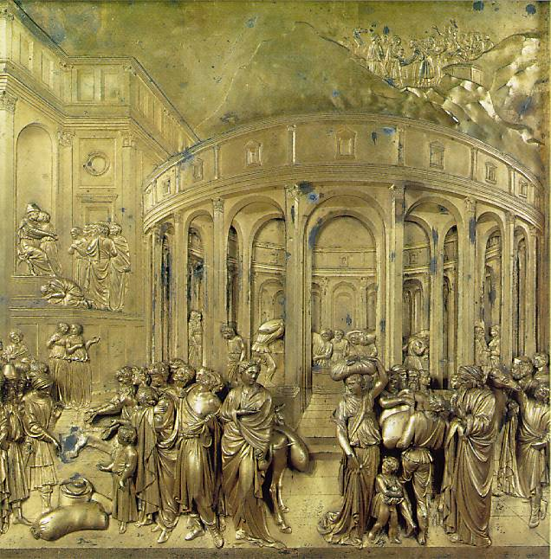
Ghiberti – Gates of Paradise Baptistry Door, Florence – 1425 - 1452
The Winner!

Slide 28
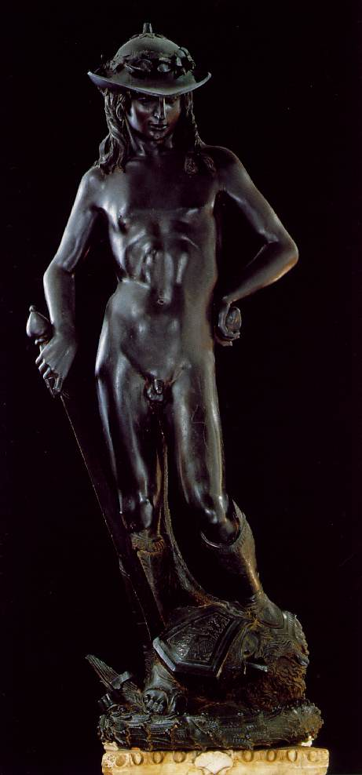
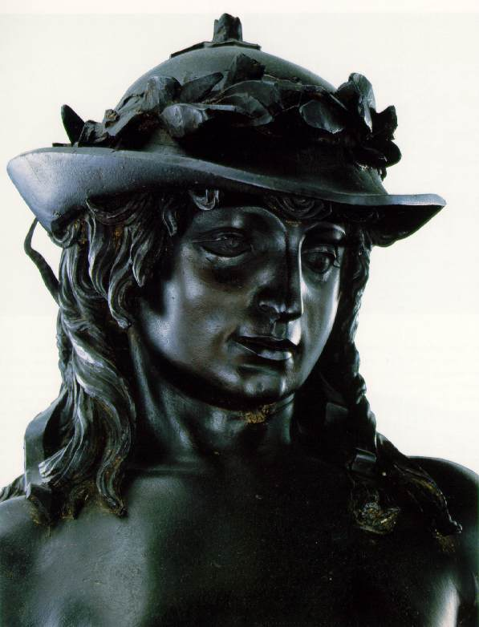
The Liberation of Sculpture
David by Donatello
1430
First free-form bronze since Roman times!

Slide 29
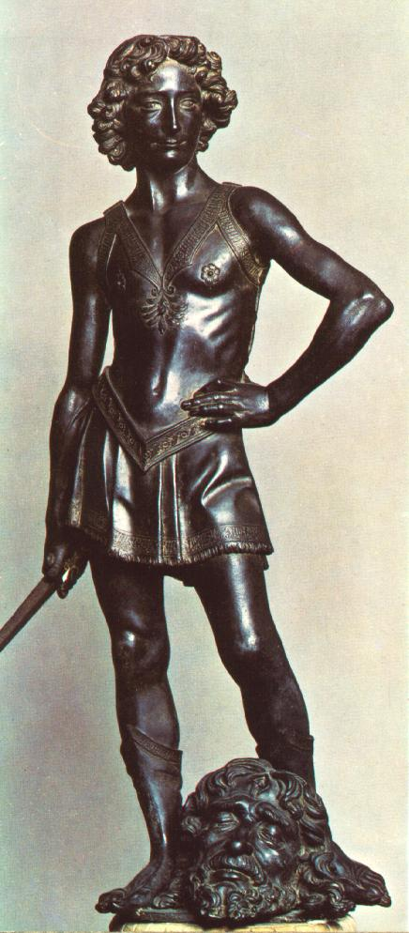
David Verrocchio 1473 - 1475

Slide 30
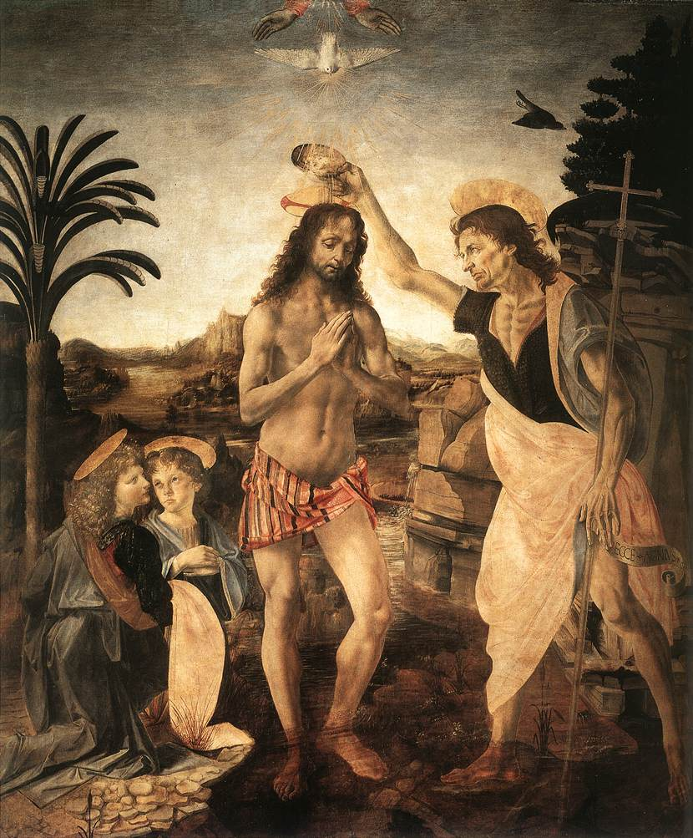
The Baptism of Christ Verrocchio, 1472 - 1475
Leonardo da Vinci

Slide 31
The
Renaissance
'Individual'

Slide 32
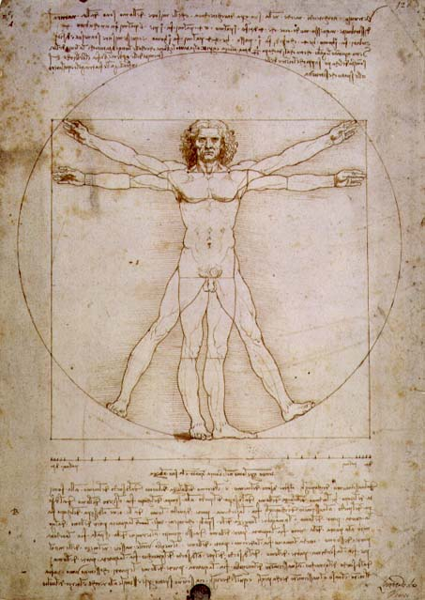
Vitruvian Man
Leonardo da Vinci
1492
The L’uomo universale

Slide 33
The Renaissance “Man”
Broad knowledge about many things in different fields.
Deep knowledge/skill in one area.
Able to link information from different areas/disciplines and create new knowledge.
The Greek ideal of the “well-rounded man” was at the heart of Renaissance education.

Slide 34
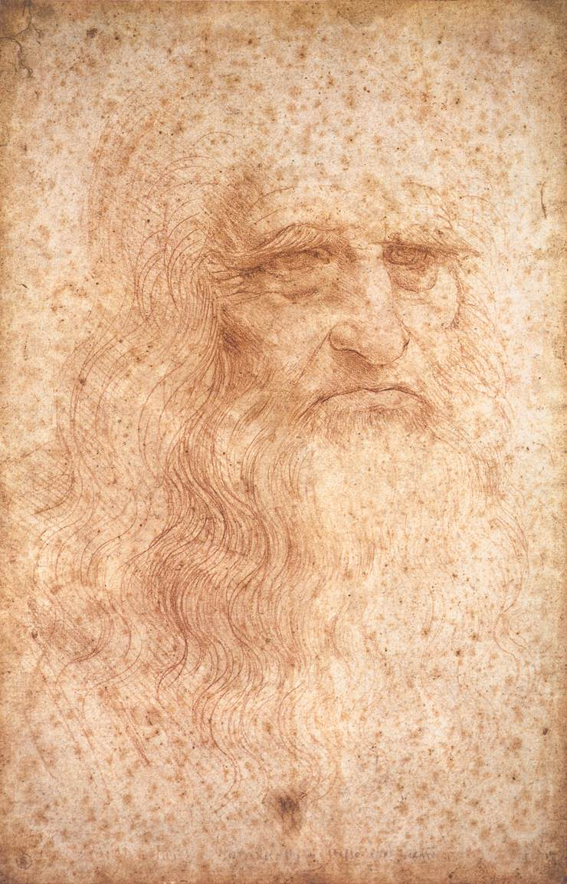
1. Self-Portrait -- da Vinci, 1512
Artist
Sculptor
Architect
Scientist
Engineer
Inventor
1452 - 1519

Slide 35
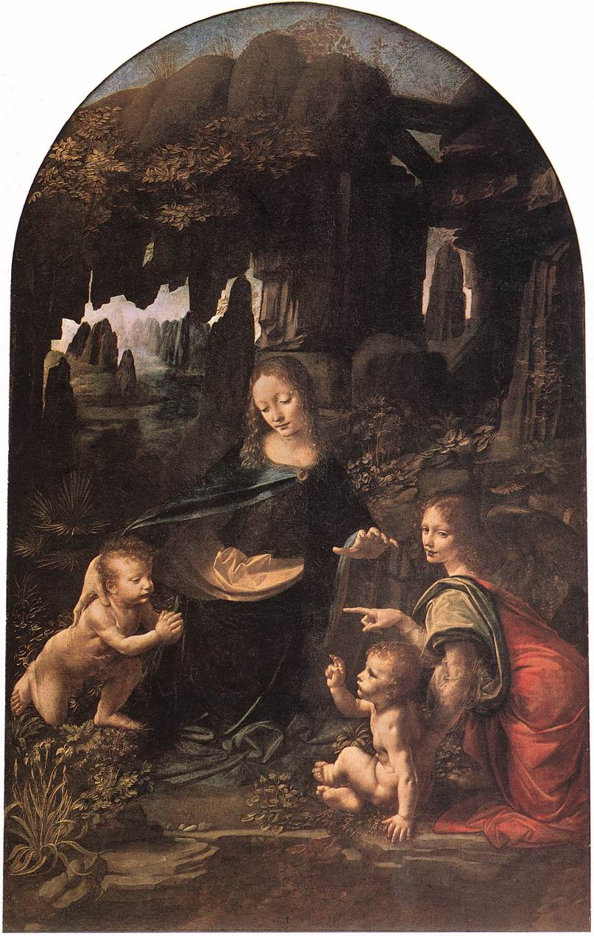
Leonardo, the Artist
The Virgin of the Rocks
Leonardo da Vinci
1483-1486

Slide 36
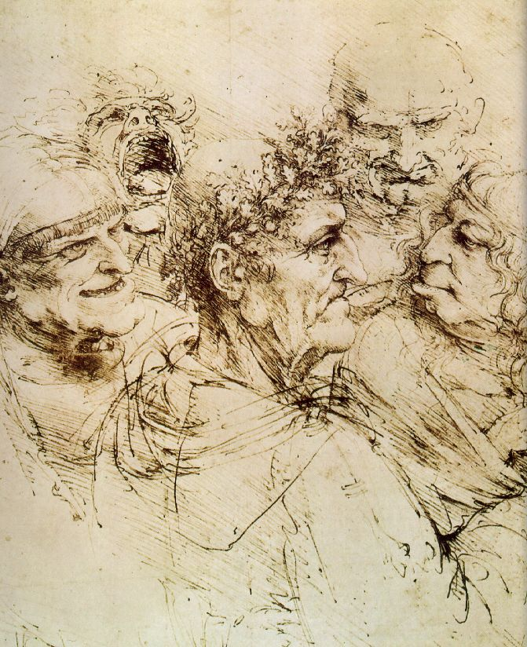
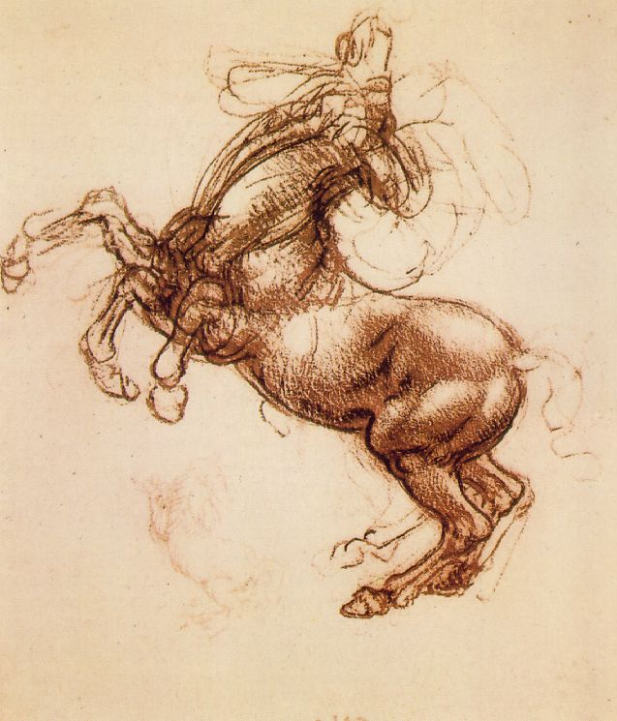
Leonardo, the Artist: From hisNotebooks of over 5000 pages (1508-1519)

Slide 37
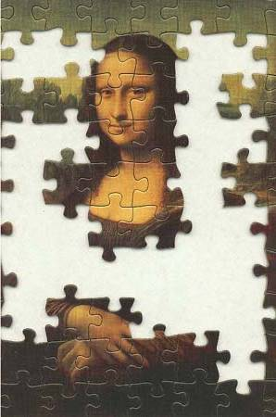
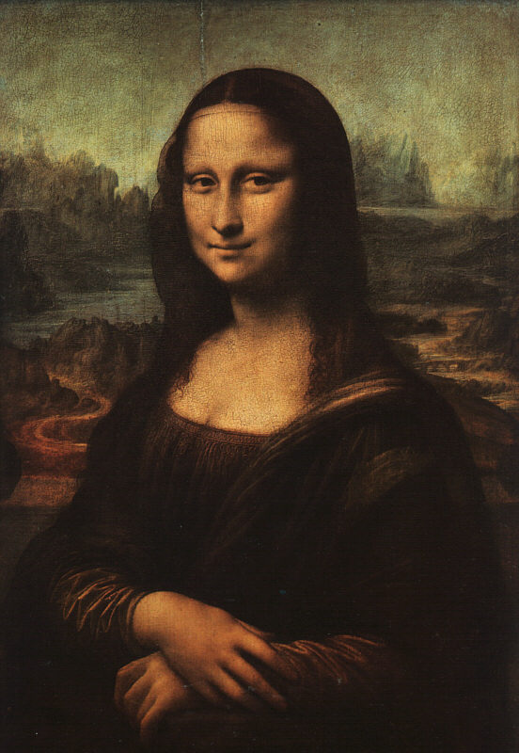
Mona Lisa – da Vinci, 1503-4
?

Slide 38
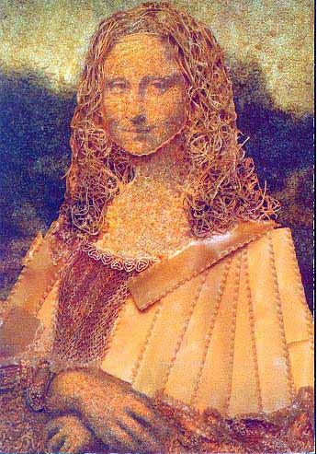
Parody→The Best Form of Flattery?
A Macaroni Mona

Slide 39
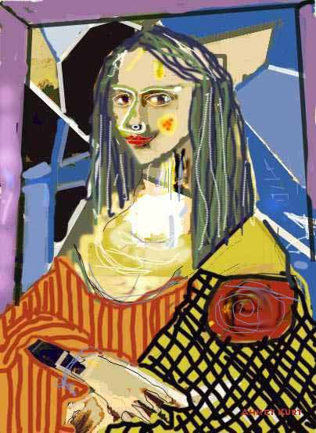
A Picasso Mona

Slide 40
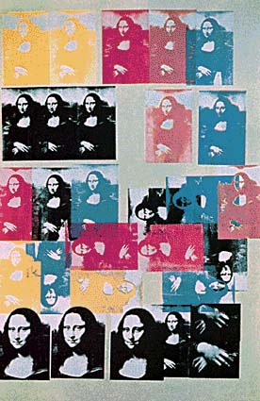
An Andy Warhol Mona

Slide 41
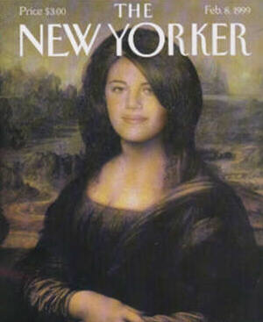
A “Mona”ca Lewinsky

Slide 42
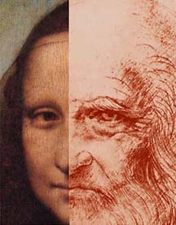
Mona Lisa OR da Vinci??

Slide 43
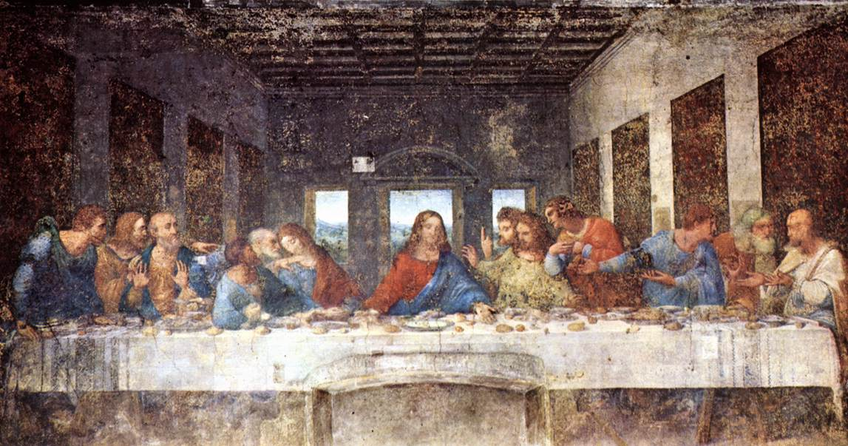
The Last Supper - da Vinci, 1498 & Geometry

Slide 44
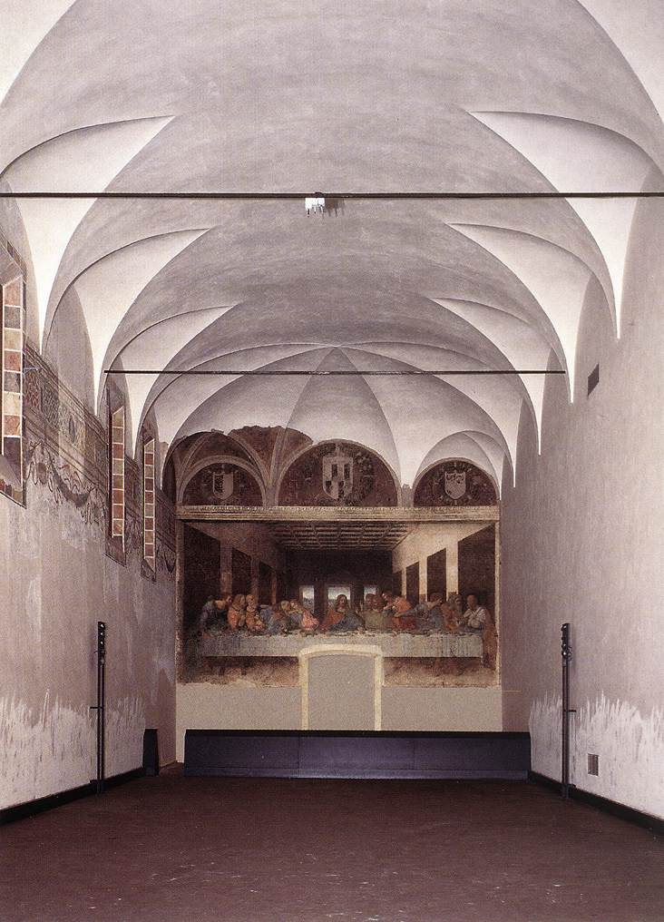
Refractory
Convent of Santa Maria delle Grazie
Milan

Slide 45
The Last Supper - da Vinci, 1498
vertical
horizontal
Perspective!

Slide 46
Deterioration
Detail of Jesus
The Last Supper
Leonardo da Vinci
1498

Slide 47
A Da Vinci “Code”: St. John or Mary Magdalene?

Slide 48
Leonardo, the Sculptor
An Equestrian Statue
1516-1518

Slide 49
Leonardo, the Architect: Pages from his Notebook
Study of a central church.
1488

Slide 50
Leonardo, the Architect: Pages from his Notebook
Plan of the city of Imola, 1502.

Slide 51
Leonardo, the Scientist (Biology): Pages from his Notebook
An example of the humanist desire to unlock the secrets of nature.

Slide 52
Leonardo, the Scientist (Anatomy): Pages from his Notebook

Slide 53
Leonardo, the Inventor: Pages from his Notebook

Slide 54
Man Can Fly?

Slide 55
Leonardo, the Engineer: Pages from his Notebook
Studies of water-lifting devices.
A study of siege defenses.

Slide 56
Leonardo da Vinci….
O investigator, do not flatter yourself that you know the things nature performs for herself, but rejoice in knowing that purpose of those things designed by your own mind.

Slide 57
Renaissance Rome

Slide 58
2. Michelangelo Buonorrati
1475 – 1564
He represented the body in three dimensions of sculpture.

Slide 59
David
Michelangelo Buonarotti
1504
Marble

Slide 60
← 15c
What a difference a century makes!
16c →

Slide 61
The Popes as Patrons of the Arts
The Pieta
Michelangelo Buonarroti
1499
marble

Slide 62
The Sistine Chapel Michelangelo Buonarroti 1508 - 1512

Slide 63
The Sistine Chapel’s Ceiling Michelangelo Buonarroti 1508 - 1512

Slide 64
The Sistine Chapel Details
The Creation of the Heavens

Slide 65
The Sistine Chapel Details
Creation of Man

Slide 66
A Modern “Adaptation”
Joe Gallo in the New York Daily News, 2004

Slide 67
The Sistine Chapel Details
The Fall from Grace

Slide 68
The Sistine Chapel Details
The Last Judgment

Slide 69
3. Raffaello Sanzio (1483-1520)
Self-Portrait, 1506
Portrait of the Artist with a Friend, 1518

Slide 70
Baldassare Castiglione by Raphael, 1514-1515
Castiglione represented the humanist “gentleman” as a man of refinement and self-control.

Slide 71
Perspective!
Betrothal of the Virgin
Raphael
1504

Slide 72
Raphael’s Canagiani Madonna, 1507

Slide 73
Raphael’s Madonnas (1)
Sistine Madonna
Cowpepper Madonna

Slide 74
Raphael’s Madonnas (2)
Madonna della Sedia
Alba Madonna

Slide 75
The School of Athens – Raphael, 1510 -11
One point perspective.
All of the important Greek philosophers and thinkers are included → all of the great personalities of the Seven Liberal Arts!
A great variety of poses.
Located in the papal apartments library.
Raphael worked on this commission simultaneously as Michelangelo was doing the Sistine Chapel.
No Christian themes here.

Slide 76
The School of Athens – Raphael, 1510 -11
Da Vinci
Raphael
Michelangelo

Slide 77
The School of Athens – Raphael, details
Plato: looks to the heavens [or the IDEAL realm].
Aristotle: looks to this earth [the here and now].

Slide 78
Averroes
Hypatia
Pythagoras

Slide 79
Zoroaster
Ptolemy
Euclid

Slide 80
The Liberation of St. Peter by Raphael, 1514

Slide 81
Portrait of Pope Julius II by Raphael, 1511-1512
More concerned with politics than with theology.
The “Warrior Pope.”
Great patron of Renaissance artists, especially Raphael & Michelangelo.
Died in 1513

Slide 82
Pope Leo X with Cardinal Giulio deMedici and Luigi De Rossi by Raphael, 1518-1519
A Medici Pope.
He went through the Vatican treasury in a year!
His extravagances offended even some cardinals [as well as Martin Luther!].
Started selling indulgences.

Slide 83
Birth of Venus – Botticelli, 1485
An attempt to depict perfect beauty.

Slide 84
2002 Euro Coin
Botticelli’s Venus Motif.
10¢ Italian Euro coin.

Slide 85
Primavera – Botticelli, 1482
Depicted classical gods as almost naked and life-size.

Slide 86
A Portrait of Savonarola
By Fra Bartolomeo, 1498.
Dominican friar who decried money and power.
Anti-humanist → he saw humanism as too secular, hedonistic, and corrupting.
The “Bonfire of the Vanities,” 1497.
Burned books, artwork, jewelry, and other luxury goods in public.
Even Botticelli put some of his paintings on the fire!!

Slide 87
The Execution of Savonarola, 1452

Slide 88
Venice During the Renaissance

Slide 89
The Doge, Leonardo Loredon Berlini, 1501

Slide 90
Venus of Urbino – Titian, 1558

Slide 91
The Penitent Mary Magdalene by Titian, 1533
By the mid-16c, High Renaissance art was declining.
Mannerism became more popular.
This painting is a good example of this new artistic style.

